Slide 1

Team Project - Team C5
Thomas Clarke, Mihnea Patentasu, Piotrek Wilczyński, Danyil Ilchenko, Owen Pemberton, Botond Megyesfalvi

Slide 2
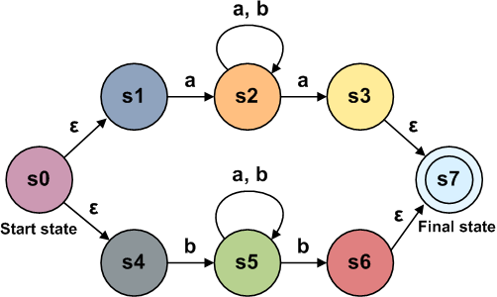
Introduction
What is our product?
Who is our target audience?
What is its role?
What is an automaton?
Figure: Nondeterministic finite automaton
Notes:
What we want to do is to present our product which is a standalone learning tool that can be used by university students and lecturers in modules closely related to automata theory. Currently there are no other similar learning tools on the market.
Automaton theory: An automaton is a finite state machine that can be seen as a computing machine which is especially suitable for string matching. It accepts a certain language that follow a pattern/regular expression. This is an important practical technique used by software such as “grep”. Our application shows all the steps of building an automaton from a regular expression and testing if words are accepted. Now it will be best if we put our product to the test and show in more detail what steps are being visualised in the construction of an automaton from a regular expression.

Slide 3
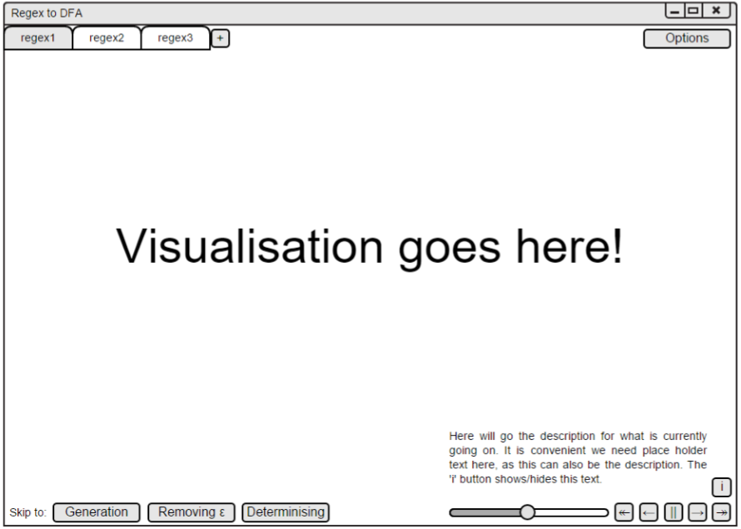
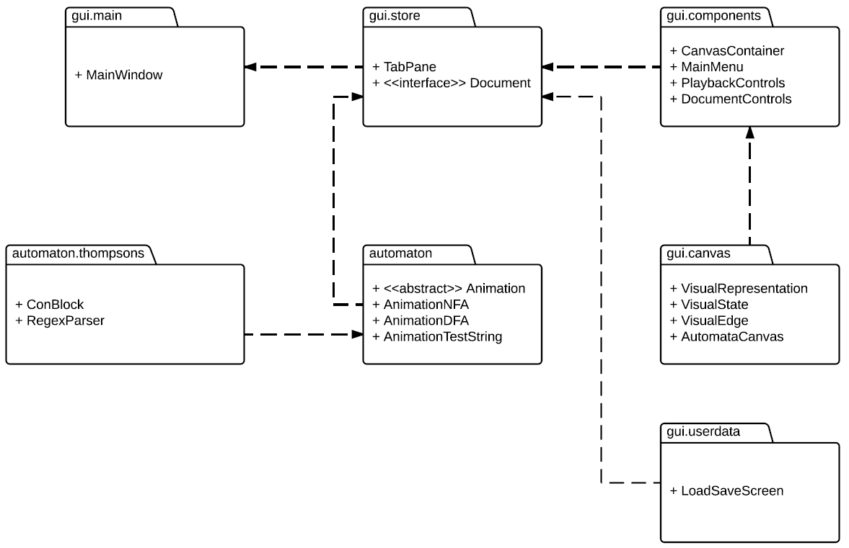
Software Engineering - Development
Class diagram designs for algorithms
Modular packages
MVC, but not strictly followed
Drawn visual designs for GUI
Agile methodology, along with SCRUM style sprints
Gantt chart
Target of an early prototype
Notes:
Design time
Algorithmic code - UML class diagrams
Modular so maintainable, lowest dependencies on other modules as we could do, extendible
Show the package diagram, easy to see seperate modules
Took inspiration from MVC, but changed it to suit us
Model: simulation branch
View and Controller: Documents and components
GUI
Drawn designs for interface
Mock-ups for the main visualisation, iterated upon and evolved into final form.
Process
Informal agile as this suited the project
We had scrum inspired meetings, talking about things based on Gantt chart
Next time, spend more time deciding planned progress, but stuff always changed
Target of prototype in first few weeks
For submission
Get backbone of system done, so just useful features and polish

Slide 4
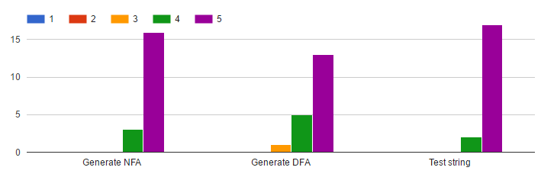
Software Engineering - Testing
Testing with JUnit and manual Testing
User testing
Dr. Paul Levy and Dr. Steve Vickers
Around 50% of our test users have had previous experience with automatas
Most said functionality and performance were ‘excellent’
Assistance in understanding was generally ‘very good’
“On a scale of 1 to 5, evaluate the way the system deals with the following algorithms.”
Notes:
Testing
JUnit for algorithmic code
Manual for GUI
User testing
Dr. Paul Levy and Dr. Steve Vickers
Show E|a
Show states in NFA to DFA closure
More ideas, but generally good project which is really a useful tool
Range of students
50% good understanding rate
*more stats*
Generally good reaction

Slide 5
Technologies
JavaFX
Standard controls (e.g. Buttons, Sliders) for user input (Controller part of MVC)
JavaFX Canvas object for drawing the visualisation (View part of MVC)
No other 3rd party libraries
Our own Graph implementation
Our own drawing routines for visualising
Notes:
Our project uses the JavaFX for both the GUI and the graph visualisation. We don’t use any third party libraries.

Slide 6

Technical Implementation
Basic model/view/controller layout.
The GUI (view and controller)
The FSA module (the model)
FSA module build the automata in stages, storing the state of the graph at each important step.
Thompsons (O(n)) and Powerset (O(2^n)) complexity
Runs in a separate thread and computes entire animation before the user interacts.
Precompute the animation
Smooth interaction
Good user experience
Notes:
So as Tom has already said, we use a basic model, view, controller layout where the GUI part of the project is both the controller and view, and the FSA module is the model. The model builds the automata in stages, storing the state of the graph at each stage in what we call a “Visual Representation”. We did consider generating the FSA in real-time but the Powerset construction algorithm computes in 2^n time, so for large automatas the user would be waiting just to move the animation forward and this isn’t good for the user’s experience. We decided that it would be better to perform all construction computation before the user interacts with the animation so that changing frames is instant and the animation plays smoothly.

Slide 7
Teamwork
Meetings 3 times a week
Pair programming
Problem - top-down or bottom-up
Facebook chat, Google Drive
Gantt chart
SVN

Slide 8
Potential improvements
Zooming in and out
Minimization of DFA
Bottom-up approach

Slide 9
Thank you! Are there any questions?

